Slide 1

      FULL-TIME BENEFITS ELIGIBLE EMPLOYEES

Slide 2
The Office of Risk and Benefits Management’s mission and vision is to promote the health and well-being of our employees. Our dedicated staff includes district personnel and on-site representatives of our benefits providers who are ready to assist and guide employees with their benefits needs.
Contact us at 305.995.7129 or email risk@dadeschools.net

Slide 3
BENEFITS SALARY
▪ Benefits salary is defined by each union’s salary schedule and it is equal to the employee’s annual base salary.
▪ Benefits salaries will be updated to meet current salary levels and will be determined for all employees annually on June 30th of each year.
▪ Benefits salary determines:
Salary Band
Employee & dependent healthcare Board contribution and employee cost per pay
Board-paid Life Insurance amount (amount is determined by your bargaining unit contract)
Determines disability benefit

Slide 4
CORE BENEFITS
HEALTH INSURANCE (EMPLOYEE ONLY COVERAGE):
▪ 90-calendar day waiting period and coverage will be effective on the 91st day
✓ Cigna OAP High (employee cost-share)
✓ Cigna OAP Standard (employee cost-share)
✓ Cigna SureFit (Board-paid)
For employee cost share and dependent rates visit www.dadeschools.net, then under Site Map click on 2024 Benefits.

Slide 5
CORE BENEFITS
LIFE INSURANCE (BOARD-PAID):
One time your annual base salary rounded up to the next $1,000 (the minimum benefit for employees represented by AFSCME is $10,000). Please make sure you indicate your beneficiary designation.
Effective on the 91st day following a 90-calendar day waiting period, you can purchase additional Optional Life Insurance equaling three times your annual salary – guaranteed enrollment only at the time of first eligibility
You can purchase dependent life insurance – guaranteed enrollment only at the time of first eligibility
To find out more about Board-Paid Term Life and Accidental Death and Dismemberment, contact the MetLife Representative at 305.995.7029.

Slide 6
CORE BENEFITS
STANDARD SHORT-TERM DISABILITY (STD) (BOARD-PAID):
➢ Short Term Disability effective on the 91st day of employment
✓ Plan pays 60% of your weekly earnings
✓ Pays up to 22 weeks of disability
➢ You can purchase the STD upgrade
✓ Guaranteed enrollment only at the time of first eligibility
✓ You will be subject to Evidence Of Insurability (EOI) when you decide
to purchase an upgrade during the Open Enrollment period

Slide 7
DECLINATION OF HEALTHCARE (OPT-OUT OPTION)
You can decline healthcare coverage
You will receive $100 per month paid bi-weekly through the payroll system based on your deduction pay schedule – this is taxable income
You will be required to provide proof of other group
or state-funded healthcare coverage
You must complete your online enrollment
You will need to complete a Declination of Healthcare Coverage Affidavit

Slide 8
SPOUSAL/DOMESTIC PARTNER SURCHARGE
If you are going to enroll a spouse/domestic partner in your healthcare plan, there will be an annual surcharge of $800 and it will be billed on a bi-weekly basis according to your pay schedule. During the online enrollment, the application will display an acknowledgement form and you will be given the opportunity to click on the box that best describes the access your dependent has to group coverage.
• Surcharge only applies if your eligible dependent has access to group healthcare coverage through his or her own employer.
• Surcharge does not apply if your eligible dependent does not have access to other group healthcare coverage through his or her employer.
• If access to group healthcare coverage changes for your eligible dependent mid-year, please contact FBMC.
Deductions Per Pay Period | Deducciones Por Periodo de Pago | Dediksyon Pou Chak Peryòd Peye
10-month employees: $40.20 | Empleado de 10 meses: $40.20 | 10 mwa anplwaye: $40.20
11-month employees: $33.50 | Empleado de 11 meses: $33.50 | 11 mwa anplwaye: $33.50
12-month employees: $30.92 | Empleado de 12 meses: $30.92 | 12 mwa anplwaye: $30.92

Slide 9
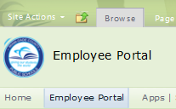
ENROLLMENT AT A GLANCE
As a new employee you will receive an email notification 60-calendar days after your date of hire prompting you to enroll online for Healthcare and Flexible Benefits. The email will provide you with your enrollment deadline.
HOW TO ENROLL:
Log on to your employee portal through
dadeschools.net and click on the SAP icon
Click on the Employee Self Service tab
Click on the Benefits link
Under Life Events, click on the New
Hire Enrollment link

Slide 10

CIGNA HEALTHCARE PLANS
OAP High:
This plan offers a higher level of coverage with a lower out-of-pocket expense when receiving services, while having access to nationwide providers in exchange for a higher premium.
No Primary Care Physician selection required
No referral for Specialists
Nationwide Provider Network
Low Deductible – deductible must be satisfied for services subject to co-insurance
Lower Primary Care Physician co-payment
Lower Urgent Care co-payment
$0 co-payment for Telemedicine
$0 co-payment for Generic Seven Drug Classes (both retail & 90-day supply)

Slide 11
CIGNA HEALTHCARE PLANS
OAP Standard:
This plan offers individuals needing less access to care a lower premium option, with access to nationwide providers in exchange for a higher out-of-pocket expense when receiving services.
No Primary Care Physician selection required
No referral for Specialists
Co-payments for Primary and Specialist visits
Co-payments for Urgent visits
Nationwide Provider Network
Low Deductible – deductible must be satisfied for services subject to co-insurance
$0 co-payment for Telemedicine
$0 co-payment for Generic Seven Drug Classes (both retail & 90-day supply)

Slide 12
CIGNA HEALTHCARE PLANS
SureFit:
This plan offers a lower out-of-pocket expense when receiving services, a lower premium, and a narrow strong network of providers. You must reside in the tri-county area (Miami-Dade, Broward and Palm Beach Counties).
Selection of Primary Care Physician required
No referral for Specialists
Narrow network with a minimum disruption in comparison to the OAP Plans
Co-payments for Primary and Specialist visits
Low co-payments for Urgent visits
Lower deductible – deductible must be satisfied for services subject to co-insurance
Lower Maximum Out of Pocket – The amount that you must pay before the plan covers 100% of all the services subject to co-insurance
$0 co-payment for Telemedicine
$0 co-payment for Generic Seven Drug Classes (both retail & 90-day supply)

Slide 13







RETAIL PHARMACY NETWORK
What pharmacies participate in the Retail Pharmacy Network?

Slide 14
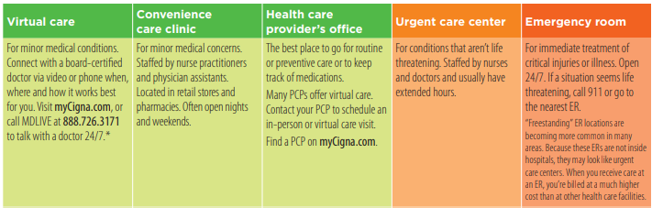
KNOW BEFORE YOU GO

Slide 15
2024 FLEXIBLE BENEFITS
You may purchase any of the offered flexible benefits for yourself or eligible dependents on a pre or post-tax basis through payroll deductions. Benefits become effective the first of the following month after your first payroll deduction.
Dental:
  Delta Dental (DHMO & PPO)
  UnitedHealthcare Dental (DHMO & PPO) (This benefit is not offered to employees represented by FOP)
Vision: EyeMed
Flexible Spending Accounts ( Medical & Dependent Care): TASC
Short Term Disability Upgrade Plans: The Standard
Long Term Disability Upgrade Plans: The Standard
Hospital Indemnity Coverage: Metropolitan Life Insurance Company (MetLife)
Legal:
  ARAG
  MetLife (This benefit is not offered to employees represented by UTD)
Identity Theft Protection: ID Watchdog
Voluntary Life: Metropolitan Life Insurance Company (MetLife)
Accidental Death & Dismemberment (AD&D):Metropolitan Life
Insurance Company (MetLife) (This benefit is not offered to employees represented by AFSCME)

Slide 16

DEPENDENT ELIGIBILITY DOCUMENTATION
Dependent Social Security Numbers are required during the enrollment process
Dependent documentation must be provided when requested. Failure to submit this required documentation will result in termination of your dependent coverage
Domestic partner of the same-sex and legally married are able to be added on a tax-free basis with a marriage certificate

Slide 17

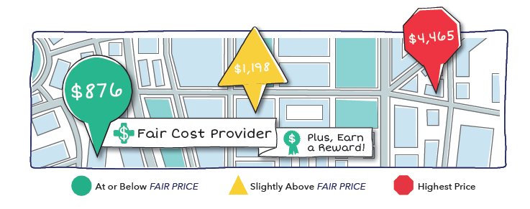

HEALTHCARE BLUEBOOK
TRANSPARENCY TOOL
Online and mobile tool that quickly helps you find cost and quality information by ranking local providers in an easy-to-read color system.
Knowing how much your care cost is just as helpful as finding the right provider.
Healthcare Bluebook is available to you as part of your benefits plan for those enrolled in a Cigna plan.
Make informed decisions with a potential cost savings by using the Transparency Tool

Slide 18

HEALTHCARE BLUEBOOK
TRANSPARENCY TOOL
Find Fair Prices and Earn Rewards
with Healthcare Bluebook
Procedure | Reward Amount
CTs | $35
MRIs | $35
Cholecystectomy (laparoscopic) | $50
Ear Tube Placement (Tympanostomy) | $50
Lithotripsy | $50
Removal of Adenoids | $50
Tonsillectomy | $50
Cataract Surgery | $100
Colonoscopy | $100
Outpatient Knee or Shoulder Surgery (arthroscopic) | $100
Upper GI Endoscopy | $100
Total Knee Replacement | $500
Total Hip Replacement | $500
Spinal Fusion | $500
Benign Breast Tumor Removal | $500
Hysterectomy | $500
$$$

Slide 19

WELL WAY
Visiting your physician for an annual physical is a great start to taking control of your health and welfare.
The mission of Miami-Dade County Public Schools Wellness Program is to:
Increase employee awareness of benefits and personal health status.
Maintain a workplace that encourages environmental and social support of healthy lifestyles.
What’s Our Goal?
Build a healthy community of employees and their dependents
Change the culture of health
Improve productivity and engagement
Decrease organizational turnover
Increase job satisfaction and morale
Decrease usage of sick days
Decrease overall healthcare cost

Slide 20


WELL WAY
(EMPLOYEES ENROLLED IN CIGNA)
Omada® is a digital lifestyle change program that
inspires healthy habits that last.
Wireless scale
Omada Health Coach
Online Group Support
Interactive Games
See if you’re eligible: go.omadahealth.com/mdcps

Slide 21

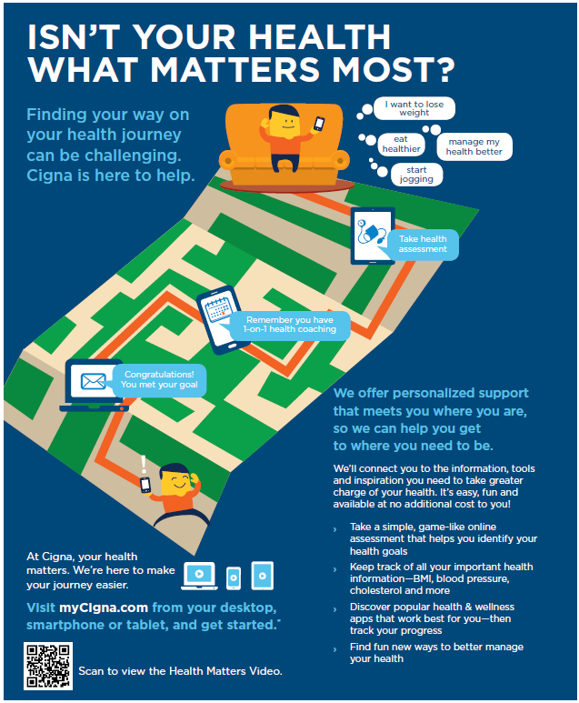
WELL WAY
Lifestyle Management Programs
Cigna Lifestyle Management Programs are easy to use and available where and when you need it.
Weight Management
Tobacco Cessation
Stress Management

Slide 22
CONTACT INFORMATION
For additional information and to schedule a personal confidential wellness session with our Wellness Educators, call 305.995.2265.
For additional information regarding your benefits, please feel free to contact us at:
Office of Risk and Benefits Management –305.995.7129
Cigna Healthcare – 1.800.806.3052
M-DCPS/Cigna Wellness Team –305.995.2265
Healthcare Bluebook – 1.888.316.5217

